Slide 1
Relationship Between Restaurant Location And Prices
Name:
Instructor:
Date:

Slide 2
Introduction
This study will examine whether there is a relationship between Asian restaurants’ locations and the prices of the restaurants.
The study involves testing of hypotheses in order to come up with valid conclusions and reliable generalization of the results.

Slide 3
Research Question and Hypotheses
Research question:
Is there statistical significant relationship between location and prices of restaurants?
Hypotheses:
H₀: There is no statistical significant relationship between location and prices of restaurants.
H_{a}: There is a statistical significant relationship between location and prices of restaurants.

Slide 4
Variables
Two categorical variables were used for this study.
Prices which had 3 levels; 1) <$10, 2) $10 - $30 and 3) >$30.
Restaurant locations consisted of 18 different locations;
1 | Bedford | 10 | Londonderry
2 | Bow | 11 | Manchester
3 | Concord | 12 | Merrimack
4 | Derry | 13 | Nashua
5 | East Hampstead | 14 | Pembroke
6 | Epsom | 15 | Penacook
7 | Hampstead | 16 | Plaistow
8 | Hooksett | 17 | Salem
9 | Hudson | 18 | Windham

Slide 5
Statistical Test Used
Chi – Square was the most appropriate test statistics in this case.
This is because the two variables are categorical and the objective of the study is determine a relationship.

Slide 6
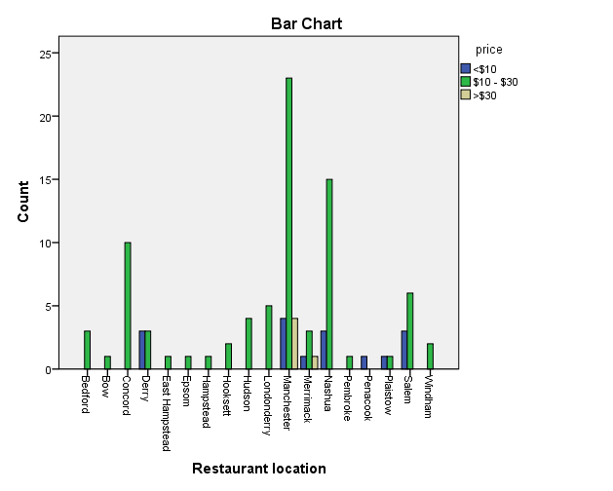
Results
According to the bar graph shown in figure 1, many of the locations had prices between $10 and $30.
Figure 1

Slide 7
Results Continued …
Table 1 shows the cross-tabulation between prices and locations of the restaurants. Analysis showed that $10-$30 group had the highest value while Manchester had the most counts.
Restaurant location * price Crosstabulation
Count
 |  | price |  |  | Total
 |  | <$10 | $10 - $30 | >$30
Restaurant location | Bedford | 0 | 3 | 0 | 3
 | Bow | 0 | 1 | 0 | 1
 | Concord | 0 | 10 | 0 | 10
 | Derry | 3 | 3 | 0 | 6
 | East Hampstead | 0 | 1 | 0 | 1
 | Epsom | 0 | 1 | 0 | 1
 | Hampstead | 0 | 1 | 0 | 1
 | Hooksett | 0 | 2 | 0 | 2
 | Hudson | 0 | 4 | 0 | 4
 | Londonderry | 0 | 5 | 0 | 5
 | Manchester | 4 | 23 | 4 | 31
 | Merrimack | 1 | 3 | 1 | 5
 | Nashua | 3 | 15 | 0 | 18
 | Pembroke | 0 | 1 | 0 | 1
 | Penacook | 1 | 0 | 0 | 1
 | Plaistow | 1 | 1 | 0 | 2
 | Salem | 3 | 6 | 0 | 9
 | Windham | 0 | 2 | 0 | 2
Total |  | 16 | 82 | 5 | 103

Slide 8

Results Continued …
The Chi-square test was conducted and the results showed in table 2 indicates that there was no significant relationship where $χ^{2}\left(34\right)=31.20, p=0.61$(Warner, 2020).
Table 2: Chi – square test
Chi-Square Tests
 | Value | df | Asymptotic Significance (2-sided)
Pearson Chi-Square | 31.204ª | 34 | .605
Likelihood Ratio | 32.471 | 34 | .543
Linear-by-Linear Association | .985 | 1 | .321
N of Valid Cases | 103
a. 50 cells (92.6%) have expected count less than 5. The minimum expected count is .05.

Slide 9
Conclusion
Since the p-value was greater than the significant level of 0.05, we fail to reject the null hypothesis and conclude that there is no statistical significant relationship between location and prices of restaurants.

Slide 10
Reference
Warner, R. M. (2020). Applied Statistics I: Basic Bivariate Techniques. SAGE Publications.

